Slide 1
XenApp with PowerShell Desired State Configuration #DuCUG September 2015

Slide 2
Agenda
Er? You desire what?!
Microsoft RDS and DSC
Citrix XenDesktop and DSC
Demo time!
Wrap up
Questions
Notes:
Overview:
What is DSC?, Why use DSC?, Why wouldn’t you use DSC?!

Slide 3

Iain Brighton
Principal Consultant @ Virtual Engine
Automation and end-user computing focused
RES Consulting Partner
E2E sponsor
RES Certified Trainer (RCT) and Valued Professional (RSVP)
Amateur C# developer and PowerShell “junkie”
Virtual Engine Toolkit (VET)
App-V Configuration Editor (ACE)
App-V Package Management provider
PScribo PowerShell documentation framework

Slide 4
What is Desired State Configuration?
“DSC is a new management platform in Windows PowerShell that enables deploying and managing configuration data for software services and managing the environment in which these services run.”

Slide 5
New Management Platform?!
Standards-based
DMTF Managed Object Framework (.MOF) document
Linux support via OMI
Declarative document
Defines the target state
Contains no implementation details
PowerShell is not required to author documents
Idempotent resources
Rinse and repeat
Eventually consistent
Notes:
Declarative = define expected behaviour, imperative = specify the implementation

Slide 6
Why Use DSC?
Windows-native
Support in Windows Management Framework 4.0
Traditional deployment methodologies don’t work in the cloud
OSD, MDT, WDS and/or PVS
Image management (except MCS in AWS)
It’s “just” a document
Great for version control/change management
Self-documenting
Environmental separation
Continuous integration
Dev > Test > UAT > Production
Notes:
Declarative document -

Slide 7
Architecture
Authoring Phase
Staging Phase
Implementation Phase

Slide 8
Architecture
Authoring Phase
Staging Phase
Implementation Phase
v5
v5
v5

Slide 9
PowerShell Authoring
#requires -version 4
configuration DemoConfiguration {
param (
[System.String[]] $ComputerName
)
node $ComputerName {
File Reports {
DestinationPath = 'C:\Reports';
Ensure = 'Present';
Type = 'Directory';
}
Service WindowsUpdate {
Name = 'wuauserv';
StartupType = 'Automatic';
State = 'Running';
}
WindowsFeature RemoteDesktopServices {
Name = 'RDS-RD-Server';
Ensure = 'Present';
DependsOn = '[Service]WindowsUpdate';
}
} #end node
} #end configuration
...
instance of MSFT_ServiceResource as $MSFT_ServiceResource1ref
{
ResourceID = "[Service]WindowsUpdate";
State = "Running";
SourceInfo = “C:\\TestLab\\Resources\\DSCConfigurations\\..
Name = "wuauserv";
StartupType = "Automatic";
ModuleName = "PSDesiredStateConfiguration";
ModuleVersion = "1.0";
};
instance of MSFT_RoleResource as $MSFT_RoleResource1ref
{
ResourceID = "[WindowsFeature]RemoteDesktopServices";
Ensure = "Present";
SourceInfo = "C:\\TestLab\\Resources\\DSCConfigurations\\..
Name = "RDS-RD-Server";
ModuleName = "PSDesiredStateConfiguration";
ModuleVersion = "1.0";
DependsOn = {
"[Service]WindowsUpdate"};
};
...

Slide 10
Our Requirements
Native
Little or no reliance on 3rd party products
2008 R2+ (with WMF 4.0)
Hypervisor- and cloud-agnostic
Deploy locally, on premises or in the cloud
Use cases
Local and/or cloud training environments
Local and/or cloud development environments
Local and/or cloud test environments
Local and/or cloud RES Showcase environments

Slide 11
Microsoft RDS DSC Resources
xRemoteDesktopSessionHost
xRDSessionDeployment, xRDSessionCollection, xRDSessionCollectionConfiguration and xRDRemoteApp
Now open source!
https://github.com/PowerShell/xRemoteDesktopSessionHost
cRemoteDesktopServices
Open source community resource created by Nicholas Dille
cRDSessionHost, cRDWebAccessHost, cRDSessionDeployment
https://github.com/nicholasdille/DSCResources
Requires WMF 5.0

Slide 12
Citrix XenDesktop DSC Resources
CitrixXenDesktop
Citrix_XenDesktopRole
Released by Citrix Labs (Brian Ehlert)
Now Open Source!
https://github.com//brianehlert/DSC
http://blogs.citrix.com/2014/09/18/what-is-desired-state-configuration/

Slide 13

…to the Bat cave!

Slide 14
@$!#!?%
Delivery Controller = 614 cmdlets
Storefront = 106 cmdlets
XenDesktop cmdlets
Have to run with a domain account
No –Credential parameter on (any) Citrix XenDesktop cmdlets
No –Credential parameter on Invoke-Command -ScriptBlock
DSC runs as LOCALSYSTEM
LOCAL SYSTEM cannot impersonate
Notes:
Declarative document -

Slide 15
Think big
Start small
Move fast

Slide 16

Citrix and Powershell

Slide 17
XenDesktop Resources
Open source!
Released at E2E June 2015
CitrixXenDesktop7
16 x new targeted DSC resources
Should* work on XenDesktop 7.0 upwards
Should* be WMF 5.0/DSC 2.0 compatible
https://github.com/VirtualEngine/CitrixXenDesktop7
CitrixXenDesktop7Lab
8 x new composite DSC resources
Hides the complexity of CitrixXenDesktop7 resources
Requires xCredSSP, xWebAdministration and cPfxCertificate
https://github.com/VirtualEngine/CitrixXenDesktop7Lab

Slide 18
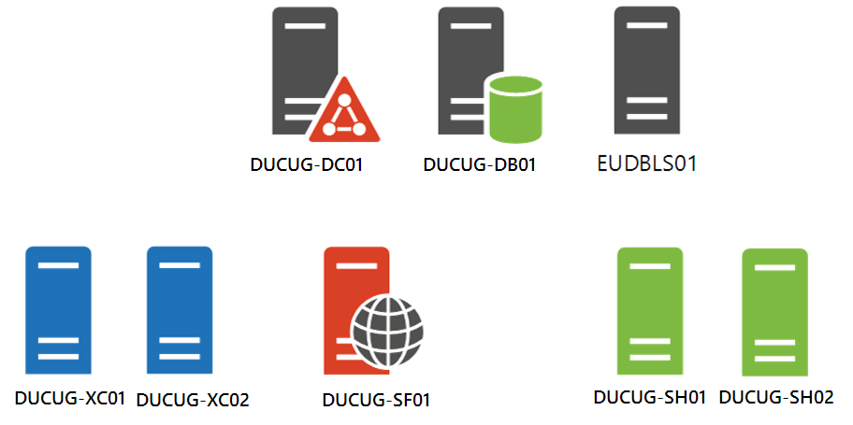
Partial Deployment

Slide 19
Pre-Installation Tasks
Hyper-V Host
Created an anonymous file share
LCM runs under LOCALSYSTEM context
Downloaded, extracted and shared XenDesktop ISO
Updated to License server version 11.12.1
Downloaded and shared Citrix XenDesktop license file
All VMs
Fully patched (including KB2883200 and KB3000850)
Installed required DSC resources
Installed self-signed public root CA certificate
Installed self-signed Client certificate (with private key)

Slide 20
Pre-Installation Tasks Cont.
DUCUG-DC01
Installed Active Directory and DNS
CNAME created for ‘storefront.testlab.local’
Created XenDesktop user accounts/groups
‘TESTLAB\XDA’ account is local administrator on all servers
DUCUG-DB01
Installed SQL 2012 Express
DUCUG-SF01
Installed Internet Information Services role features*
DUCUG-SH01 / DUCUG-SH02
Installed Desktop Experience and Remote Assistance*
Notes:
Created “XenDesktop Admins”, “XenDesktop Users” groups and “XDA” and “XDU” users accounts
* Pre-installed in the interests of time, but are included in the composite resources

Slide 21
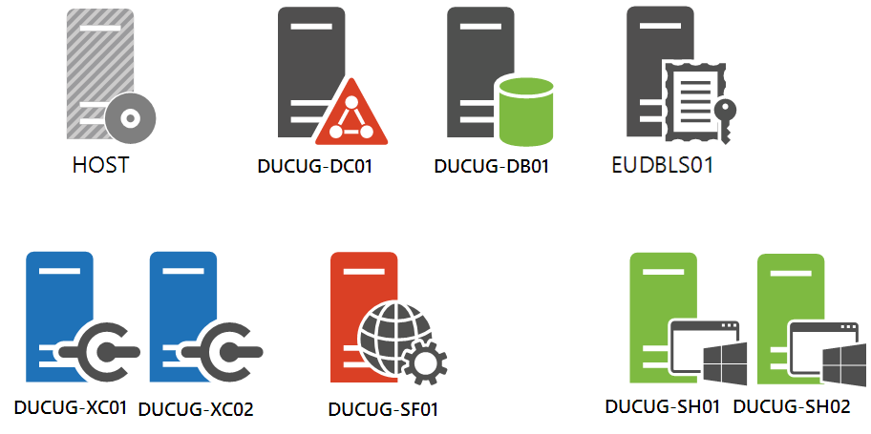
Complete Deployment

Slide 22
Prerequisites
Certificate(s)
For DSC credential encryption
DSC Resources
Microsoft resources now open-source – https://github.com/powershell
Powershell.org resources – https://github.com/powershellorg
Citrix XenDesktop media
Updated to License server version 11.12.1
Citrix XenDesktop license*
Notes:
Bundled License server version 10.0.0.14008 doesn’t work in an unattended/LOCAL SYSTEM install

Slide 23
Prerequisites Cont.
KB2883200
%ProgramFiles%\WindowsPowershell\Modules
KB3000850
Start-DSCConfiguration –UseExisting
Stop-DSCConfiguration
Remove-DSCConfigurationDocument
Update-DSCConfiguration
DependsOn

Slide 24
☺ Pray to the demo Gods

Slide 25
Why/When Not to Use DSC?
Disruptive operational change
Cloud management technologies are disruptive
DSC != Infrastructure as code
Requires additional orchestration
AWS CloudFormation and Azure Resource Manager Templates
Chef and Puppet
Citrix Lifecycle Management etc.
Not all services are a good candidate
Active Directory users/groups?
DNS client host records?
Patching?!

Slide 26
SCCM DCM versus DSC
Desired Configuration Mgmt
Desired State Configuration
Stable environments
Slow and planned growth
Unique configurations
On premises
Large infrastructure
Rapidly changing environments and continuous deployment
Scalability
No “identities”
Cloud and on premises
No infrastructure and no Active Directory

Slide 27
DSC 2.0 Enhancements
Push and Pull Partial Configurations
Pull resources from SMB
Pull configurations from OData web server
Pull server configuration guids removed
PsDscRunAsCredential
Scheduled Tasks Removed
Class-based resources

Slide 28
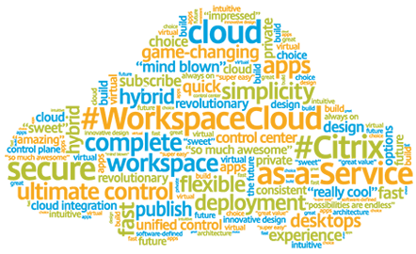
Citrix Workspace Cloud
& Citrix Lifecycle Management
Notes:
DSC no longer required? DSC no longer relevant?

Slide 29
What’s Next?
Community contributions
XenDesktop 7.x testing
Resources
Storefront/X1
Application
Controller HTTPS communication
PVS/MCS machine catalogs
Citrix Receiver
Cloud platform integration
AWS CloudFormation Templates
Azure Resource Manager Templates
Citrix Lifecycle Management

Slide 30
Additional Resources
Getting Started with DSC (Series)
http://channel9.msdn.com/Series/Getting-Started-with-PowerShell-Desired-State-Configuration-DSC
Advanced DSC and custom resources (Series)
http://channel9.msdn.com/Series/Advanced-PowerShell-Desired-State-Configuration-DSC-and-Custom-Resources
Open source DSC resources
Microsoft – https://github.com/powershell
Powershell.org – https://github.com/powershellorg

Slide 31


Questions?
@iainbrighton
iain.brighton@virtualengine.co.uk

